Slide 1

ANALYSING POST-OPERATIVE PATIENT DATA SET
Aditya Charan
H.V. Akanksha
Preeti Thota

Slide 2
ATTRIBUTE INFORMATION
L-CORE (patient's internal temperature in C): high (> 37), mid (>= 36 and <= 37), low (< 36)
2. L-SURF (patient's surface temperature in C): high (> 36.5), mid (>= 36.5 and <= 35), low (< 35)
3. L-O2 (oxygen saturation in %): excellent (>= 98), good (>= 90 and < 98), fair (>= 80 and < 90), poor (< 80)
4. L-BP (last measurement of blood pressure): high (> 130/90), mid (<= 130/90 and >= 90/70), low (< 90/70)
5. SURF-STBL (stability of patient's surface temperature): stable, mod-stable, unstable
6. CORE-STBL (stability of patient's core temperature) stable, mod-stable, unstable

Slide 3
7. BP-STBL (stability of patient's blood pressure) stable, mod-stable, unstable.
8. COMFORT (patient's perceived comfort at the time of discharge, measured as an integer between 0 and 20).
DECISION DEPENDING ON THE ATTRIBUTES S (patient prepared to go home),
A (patient must be present in hospital).
No. of instances:48
Attributes:8

Slide 4
AIM: To determine where patients in a postoperative recovery area should be sent to next.
Importing and dealing with missing values in the dataset
Exploratory Data Analysis
Applying Decision Tree to make predictions
Steps Involved In The Study:

Slide 5
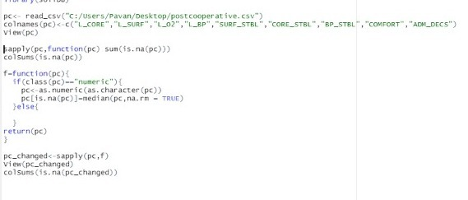
Step 1: Dealing with missing values
Every value in this dataset is important as it is a fairly small dataset and will impact the model
The missing values were dealt by replacing them with the median obtained from the data using a function.
This was considered to be the best choice as eliminating would not have been a good option considering the size of the dataset

Slide 6
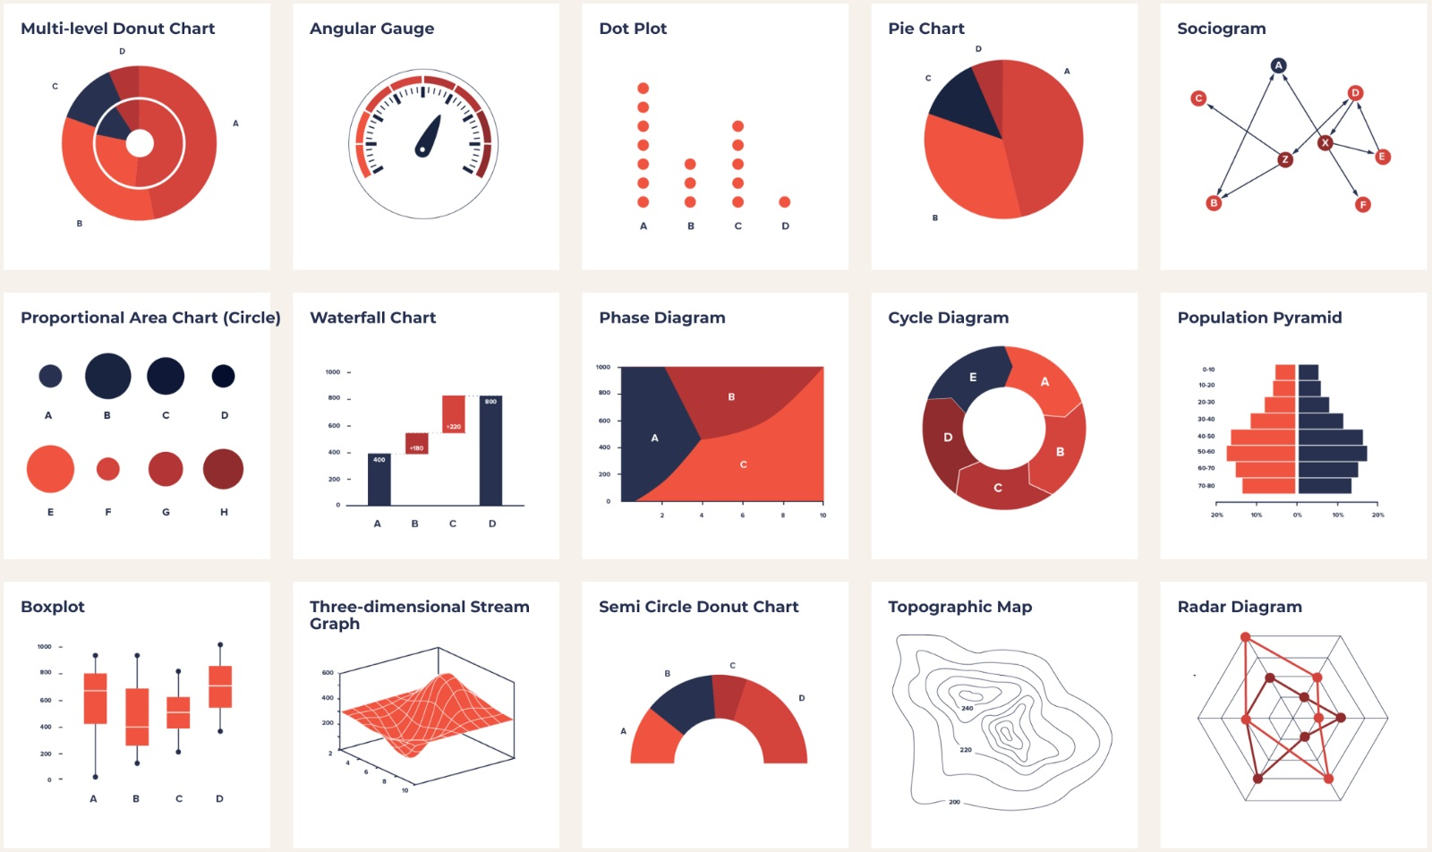
Step 2: Exploratory Data Analysis
The main purpose of EDA is to help look at data before making any assumptions. It can help identify obvious errors, as well as better understand patterns within the data, detect outliers and find the interesting relations among the variables.

Slide 7
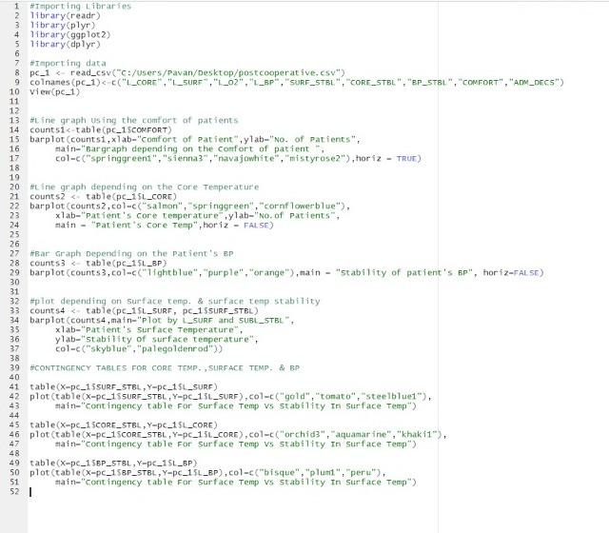
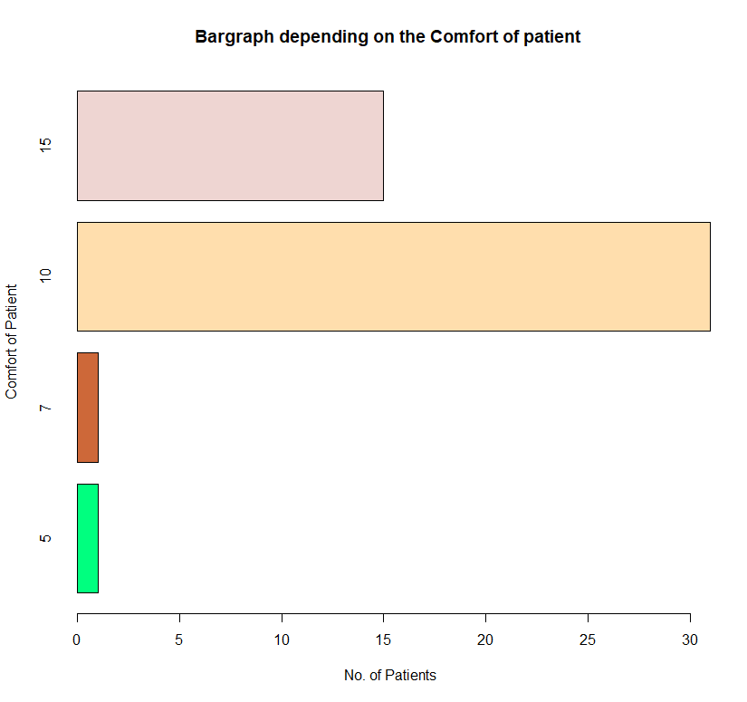
The Code
Bar graph depicting the comfort of patients

Slide 8
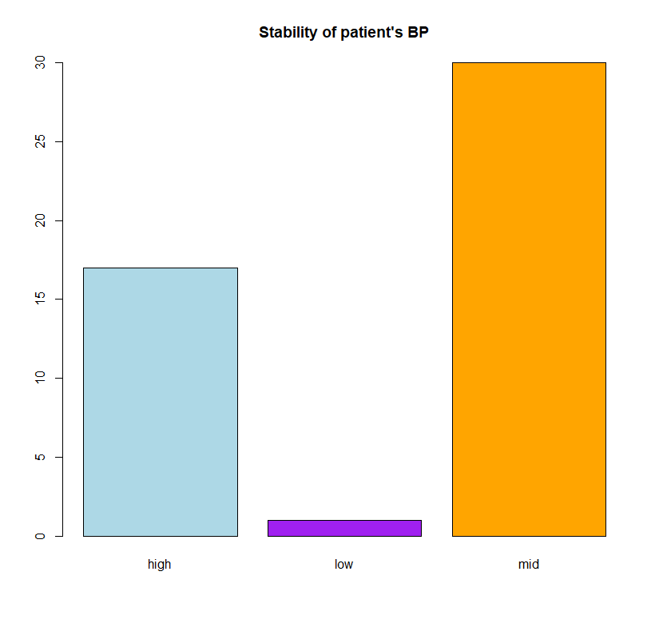
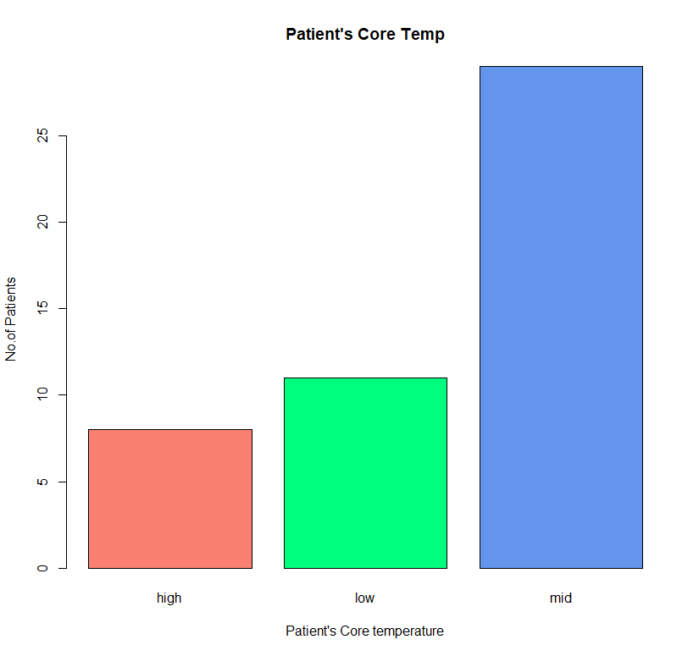
Stability of Patient’s BP
Patient’s Core Temperature

Slide 9
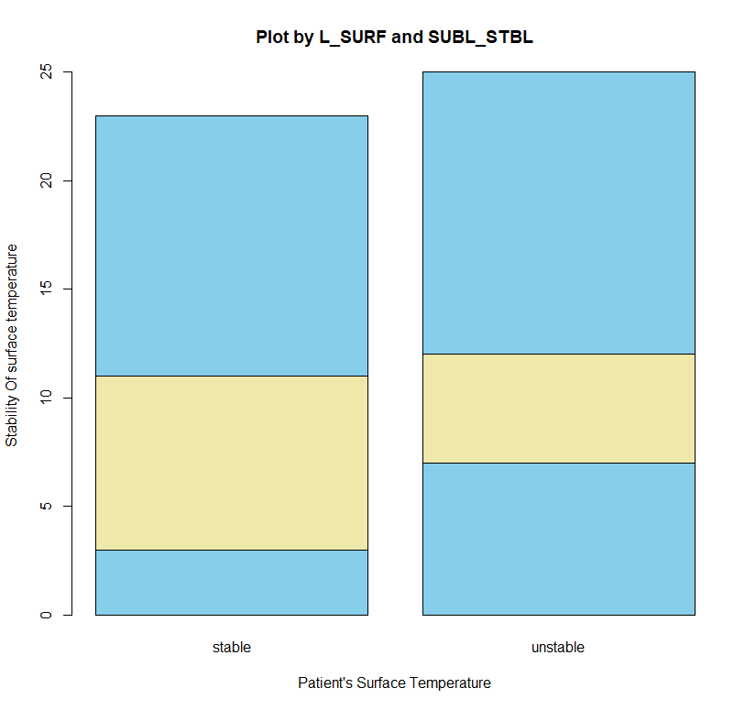
Bar plot showing L_SURF and SUBL_STBL

Slide 10
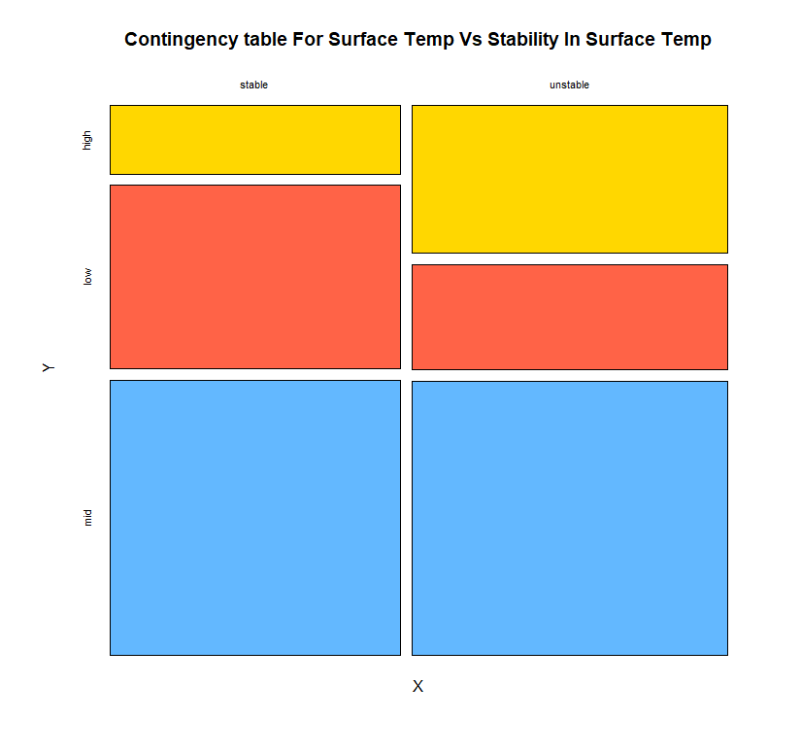
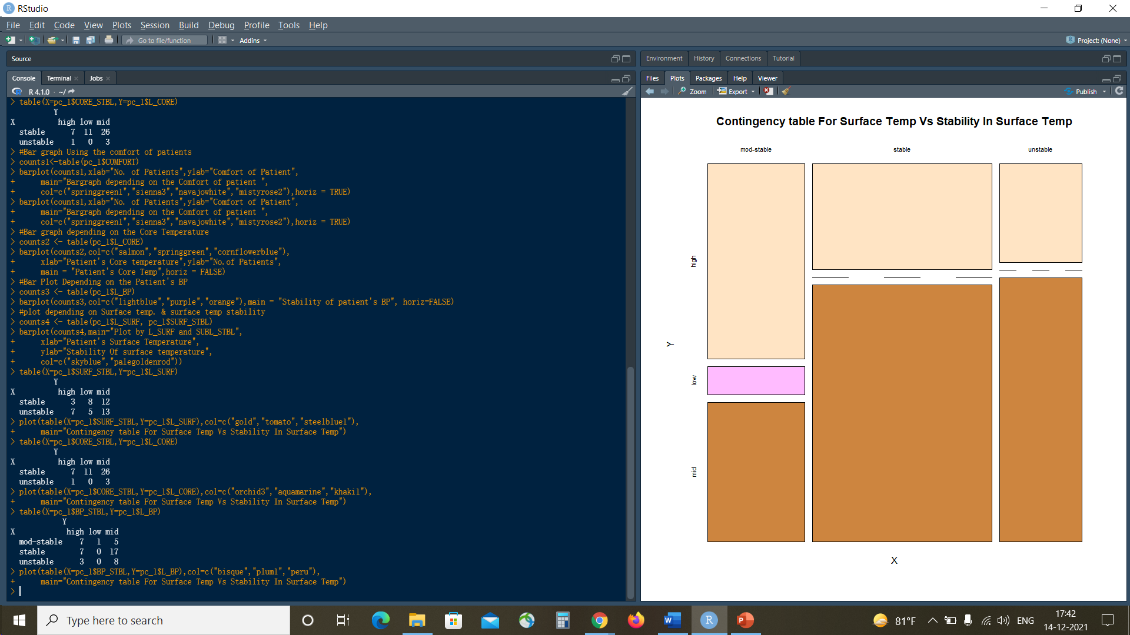
Contingency Tables
Surface Temp Vs Stability in Surface Temp

Slide 11
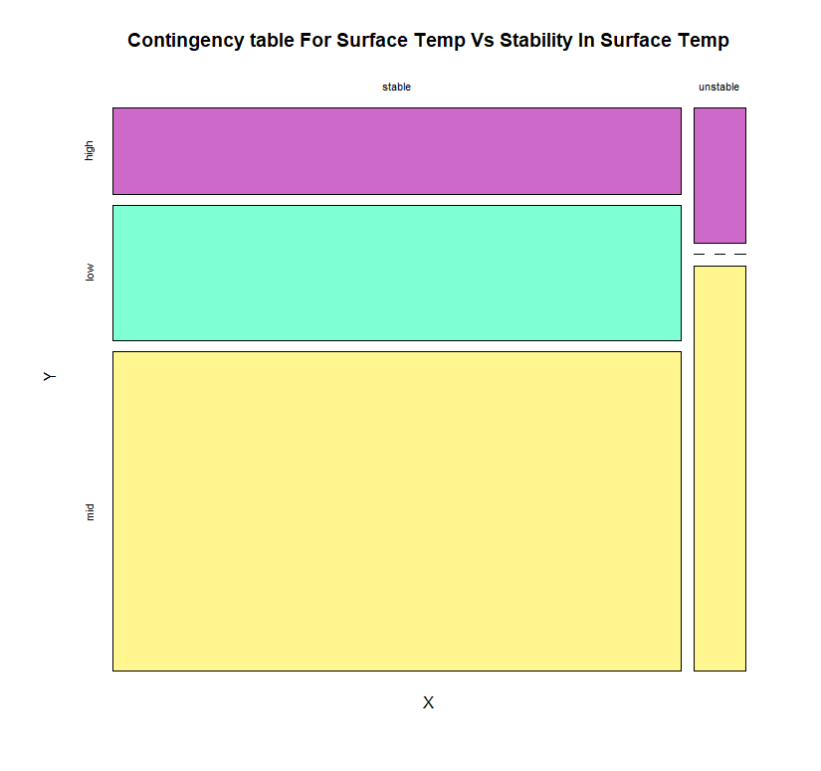
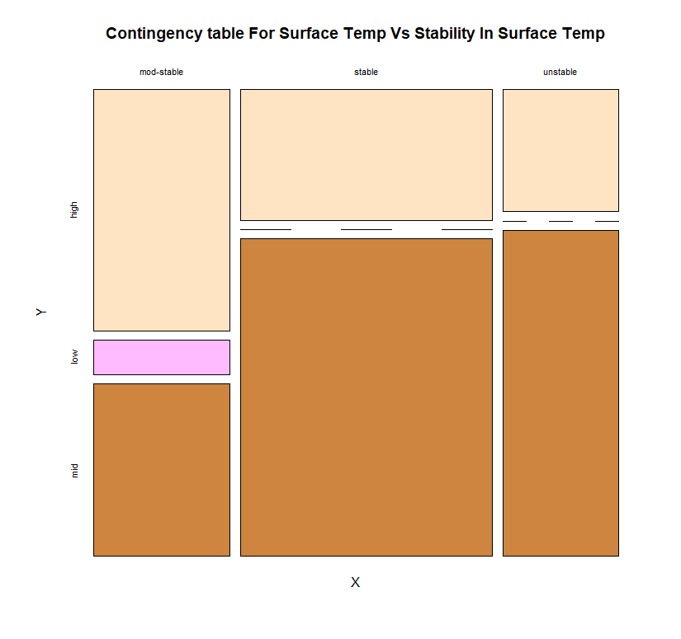
L_CORE Vs CORE_STBL
L_BP Vs BP_STBL

Slide 12
Insights obtained
Most of the patients lie in the ‘mid range’ as seen in the charts depicting the patient’s attributes and the contingency tables.
The comfort zone of most of the patients is equal to 10 i.e. more than 30 patients.

Slide 13
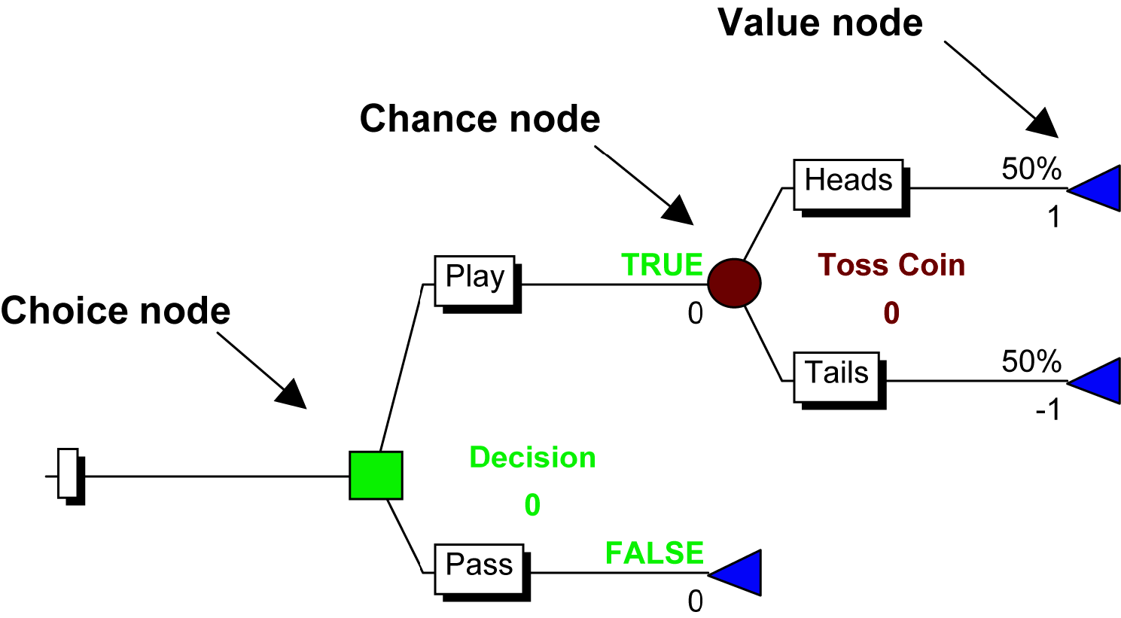
Step 3: Making predictions using Decision Tree
A decision tree is a flowchart-like structure in which each internal node represents a "test" on an attribute.
The libraries used were rpart and the functions used was rpart and plot.

Slide 14
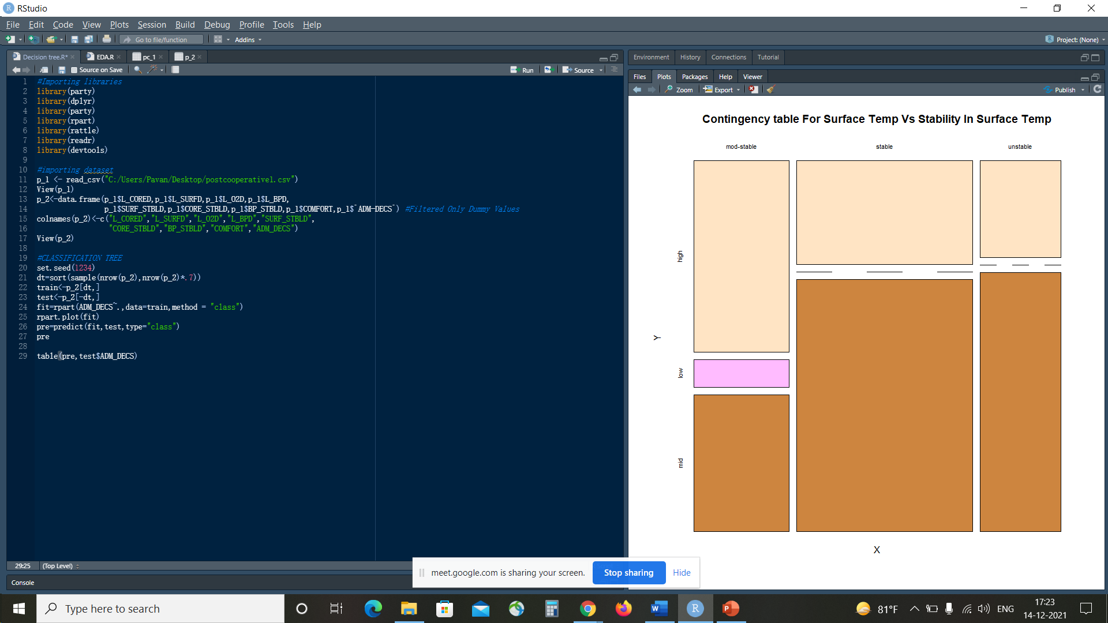
The code used to create the Decision Tree

Slide 15
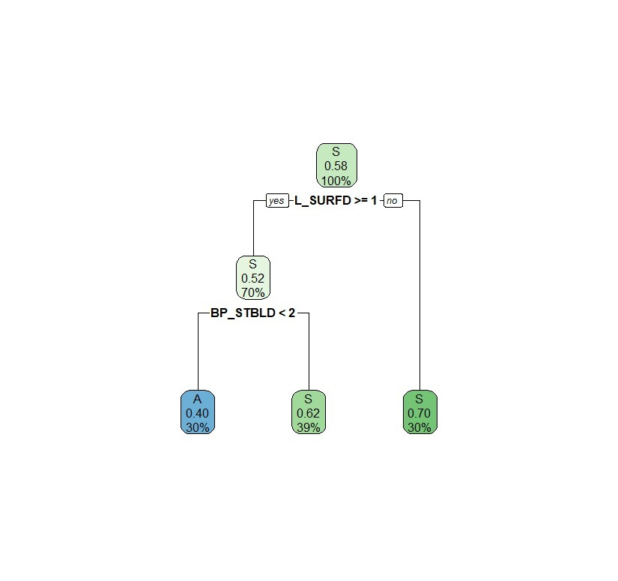
The Decision Tree

Slide 16
The Final Prediction and Conclusion
The attributes used for the prediction are A and S which give information about the patient whether to go or to stay in the hospital.
The train : test ratio is 70:30.
The accuracy of the model is 67%.

Slide 17


